Slide 1
E-governance initiatives in India
Government Interaction in e-governance
G2G: Government to Government
G2C: Government to Citizen
G2B: Government to Business
G2E: Government to Employee

Slide 2
Government to Citizen (G2C) Initiatives:
Computerization of Land Records: In collaboration with NIC. Ensuring that landowners get computerized copies of ownership, crop and tenancy and updated copies of Records of Rights (RoRs) on demand.
Bhoomi Project: Online delivery of Land Records. Self-sustainable e-Governance project for the computerized delivery of 20 million rural land records to 6.7 million farmers through 177 Government-owned kiosks in the State of Karnataka.

Slide 3
Government to Citizen (G2C) Initiatives:
Gyandoot: It is an Intranet-based Government to Citizen (G2C) service delivery initiative. It was initiated in the Dhar district of Madhya Pradesh in January 2000 with the twin objective of providing relevant information to the rural population and acting as an interface between the district administration and the people.
Lokvani Project in Uttar Pradesh: Lokvani is a public-private partnership project at Sitapur District in Uttar Pradesh which was initiated in November, 2004. Its objective is to provide a single window, self-sustainable e-Governance solution with regard to handling of grievances, land record maintenance and providing a mixture of essential services.
Project FRIENDS in Kerala: FRIENDS (Fast, Reliable, Instant, Efficient Network for the Disbursement of Services) is a Single Window Facility providing citizens the means to pay taxes and other financial dues to the State Government.The services are provided through FRIENDS Janasevana Kendrams located in the district headquarters.

Slide 4
Government to Citizen (G2C) Initiatives:
e-Mitra Project in Rajasthan: e-Mitra is an integrated project to facilitate the urban and the rural masses with maximum possible services related to different state government departments through Lokmitra-Janmitra Centers/Kiosks.
e-Seva (Andhra Pradesh): This project is designed to provide ‘Government to Citizen’ and ‘e-Business to Citizen’ services. The highlight of the eSeva project is that all the services are delivered online to consumers /citizens by connecting them to the respective government departments and providing online information at the point of service delivery.
Admission to Professional Colleges – Common Entrance Test (CET): With the rapid growth in the demand as well as supply of professional education, the process of admission to these institutions became a major challenge in the early 1990s. Recourse was then taken to ICT to make the process of admission transparent and objective. One of the pioneering efforts was made by Karnataka. The State Government decided to conduct a common entrance test based on which admission to different colleges and disciplines was made.

Slide 5
Government to Business (G2B) Initiatives:
e-Procurement Project in Andhra Pradesh and Gujarat: To reduce the time and cost of doing business for both vendors and government.
MCA 21: By the Ministry of Corporate Affairs. The project aims at providing easy and secure online access to all registry related services provided by the Union Ministry of Corporate Affairs to corporates and other stakeholders at any time and in a manner that best suits them.

Slide 6
Government to Government (G2G) Initiatives:
Khajane Project in Karnataka: It is a comprehensive online treasury computerization project of the Government of Karnataka. The project has resulted in the computerization of the entire treasury related activities of the State Government and the system has the ability to track every activity right from the approval of the State Budget to the point of rendering accounts to the government.
SmartGov (Andhra Pradesh): SmartGov has been developed to streamline operations, enhance efficiency through workflow automation and knowledge management for implementation in the Andhra Pradesh Secretariat.

Slide 7
e-Seva
e-Seva is one of the major IT project undertaken by the government of Andhra Pradesh as a part of e-governance
e-Seva is built on the success of TWINS (Twin Cities Network Services) pilot project, which was launched in December 1999 in Hyderabad, the state capital.
It is designed to provide citizens of Hyderabad and Secunderabad to handle integrated 19 services pertaining to six departments for delivery on a one-stop mode.
Services range from utility bill/tax payments, issue of certificates, provision of information and facilitation.
TWINS has been renamed e-Seva as the state government plans to extend it to major towns and municipalities in the state.
e-Seva is a citizen service with a difference, which provides a clean, transparent, efficient and effective administrative system through state-of-the-art electronic technology.
Citizens are benefited by the direct interface with the government, which saves time, energy and money and gives hassle free dealings with the administration.
All the administrative departments come to the customer under one roof offering the citizen a wide range of citizen friendly services.

Slide 8
e-Seva contd..
e-Seva is a government project built on public-private partnership model.
Infrastructure and buildings are provided by the government. Staffs are provided by the government as well as by the private sector.
Government recruits the staffs through deputation and the respective department pays salaries.
Private sector hires the staff through tenders and they are protected by the minimum wage act.
Private sector provides the network and the software.

Slide 9
Salient features of e-Seva
46 e-Seva centres (with 400 service counters) spread over the Twin Cities and Ranga Reddy District.
All service counters are facilitated with an electronic queuing system.
Operating from 8.00 am to 8.00 pm, on all working days and 9.00am to 3.00pm on holidays (Second Saturdays & Sundays).
'One-stop-shop' for over 66 G2C and B2C services.
No jurisdiction limits - any citizen in the twin cities can avail of the services at any of the 46 e-Seva service centres.
Online services: e-Forms, e-Filing, e-Payments.
Payments by cash/check/DD/credit card/Internet.

Slide 10
Cyber law
What is Cyber Law?
Cyber Law is the law governing cyber space. Cyber space is a very wide term and includes computers, networks, software, data storage devices (such as hard disks, USB disks etc), the Internet, websites, emails and even electronic devices such as cell phones, ATM machines etc.
Law encompasses the rules of conduct:
that have been approved by the government
which are in force over a certain territory
which must be obeyed by all persons on that territory.
Violation of these rules could lead to government action such as imprisonment or fine or an order to pay compensation.
Cyber law encompasses laws relating to:
Cyber Crimes
Electronic and Digital Signatures
Intellectual Property
Data Protection and Privacy

Slide 11
1. Cyber crimes are unlawful acts where the computer is used either as a tool or a target or both. The enormous growth in electronic commerce (e-commerce) and online share trading has led to a phenomenal spurt in incidents of cyber crime.
2. Electronic signatures are used to authenticate electronic records. Digital signatures are one type of electronic signature. Digital signatures satisfy three major legal requirements – signer authentication, message authentication and message integrity. The technology and efficiency of digital signatures makes them more trustworthy than hand written signatures.

Slide 12
3. Intellectual property is refers to creations of the human mind e.g. a story, a song, a painting, a design etc. The facets of intellectual property that relate to cyber space are covered by cyber law. These include:
copyright law in relation to computer software, computer source code, websites, cell phone content etc,
trademark law with relation to domain names, meta tags, mirroring, framing, linking etc
semiconductor law which relates to the protection of semiconductor integrated circuits design and layouts,
patent law in relation to computer hardware and software.
4. Data protection and privacy laws aim to achieve a fair balance between the privacy rights of the individual and the interests of data controllers such as banks, hospitals, email service providers etc. These laws seek to address the challenges to privacy caused by collecting, storing and transmitting data using new technologies.

Slide 13
Need of cyber law
1. Cyberspace is an intangible dimension that is impossible to govern and regulate using conventional law.
2. Cyberspace has complete disrespect for jurisdictional boundaries. A person in India could break into a bank’s electronic vault hosted on a computer in USA and transfer millions of Rupees to another bank in Switzerland, all within minutes. All he would need is a laptop computer and a cell phone.
3. Cyberspace handles gigantic traffic volumes every second. Billions of emails are crisscrossing the globe even as we read this, millions of websites are being accessed every minute and billions of dollars are electronically transferred around the world by banks every day.
4. Cyberspace is absolutely open to participation by all. A ten year old in Bhutan can have a live chat session with an eight year old in Bali without any regard for the distance or the anonymity between them.
5. Cyberspace offers enormous potential for anonymity to its members. Readily available encryption software and steganographic tools that seamlessly hide information within image and sound files ensure the confidentiality of information exchanged between cyber-citizens.

Slide 14
Need of cyber law contd..
6. Cyberspace offers never-seen-before economic efficiency. Billions of dollars worth of software can be traded over the Internet without the need for any government licenses, shipping and handling charges and without paying any customs duty.
7. Electronic information has become the main object of cyber crime. It is characterized by extreme mobility, which exceeds by far the mobility of persons, goods or other services. International computer networks can transfer huge amounts of data around the globe in a matter of seconds.
8. A software source code worth crores of rupees or a movie can be pirated across the globe within hours of their release.
9. Theft of corporeal information (e.g. books, papers, CD ROMs, floppy disks) is easily covered by traditional penal provisions. However, the problem begins when electronic records are copied quickly, inconspicuously and often via telecommunication facilities. Here the “original” information, so to say, remains in the “possession” of the “owner” and yet information gets stolen.

Slide 15
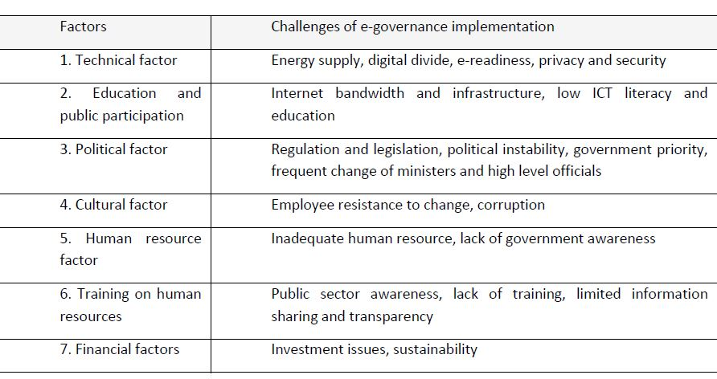
Factors influencing implementation of e-governance in Nepal

Slide 16
https://www.itu.int/osg/spu/wsis-themes/contributions/others/e-gov%20Projects.doc

